Slide 1


Supply Chain Analysis – Altiq Mart Code Basics Challenge
Presented By: Offodum Sandra
May 21, 2023

Slide 2
Outline
Introduction
Problem Statement
Goal of the Analysis
Some Major Insights
Conclusion

Slide 3

Introduction
Altiq Mart
FMCG Manufacturer
Gujarat, India.
Surat
Ahmedabad
Vadodra

Slide 4
Problem Statement
Few key customers didn’t renew their annual contract due to service issue.
Suspected Reasons
Late delivery
Not delivering in Full

Slide 5
Goal of the Analysis
Measure ‘on-time delivery (OT) %’, ‘In-full delivery (IF) %’ and On-Time-In-Full (OTIF) % of the customer orders on a daily basis against the target service level set and by cities.
Provide insights on products and customers by showing Line Fill Rate (LIFR) and Volume Fill Rate (VOFR).

Slide 6
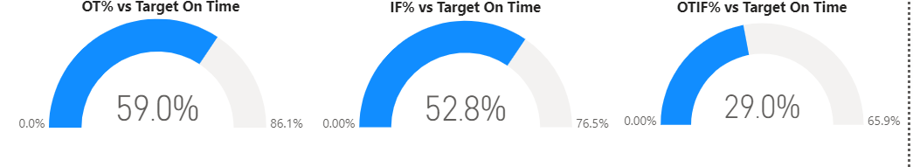
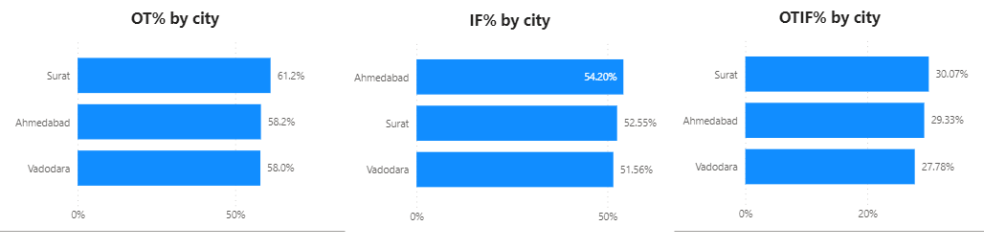
Some Major Insights
The key metrics (OT%, IF%, OTIF%) were far behind the target

Slide 7
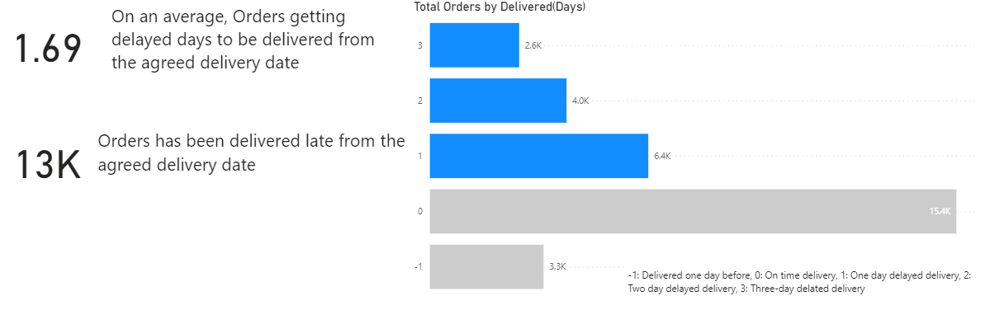
Some Major Insights…
On an average, orders were delayed 1.62 days from the agreed date of delivery
Almost half of the total orders delivered to total customers were delivered late from the agreed delivery date

Slide 8
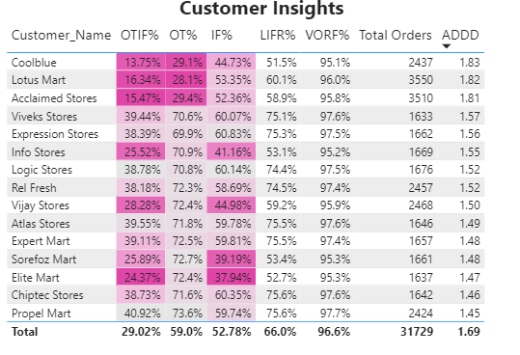
Some Major Insights…
Coolblue, Lotus Mart and Acclaimed stores got delayed the most in the delivery of their products on time
Lotus Mart, Acclaimed stores and Vijay Stores had the highest orders
There was a huge gap in OTIF% based on the target for most of the customers
For customers, the range for LIFR was between 51.5% -75.6% while that for VOFR was between 95.1% - 97.7%

Slide 9
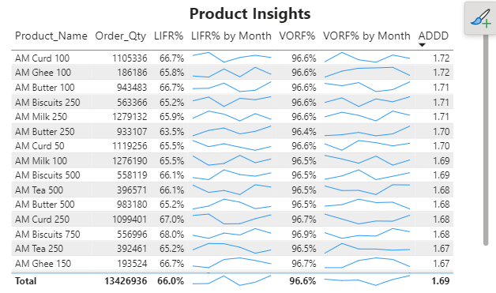
Some Major Insights…
AM Curd 100, AM Ghee 100 and AM butter 100 products were most delayed to deliver.
For products, the range for LIFR was between 63.5% - 68% while that for VOFR was between 96.4% - 96.9%.

Slide 10
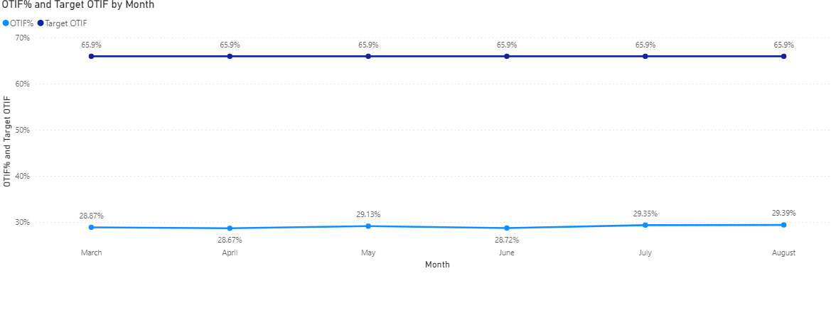
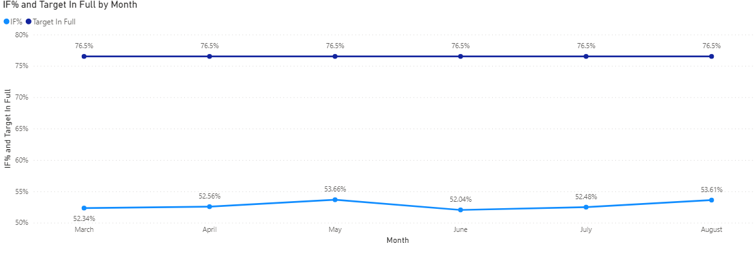
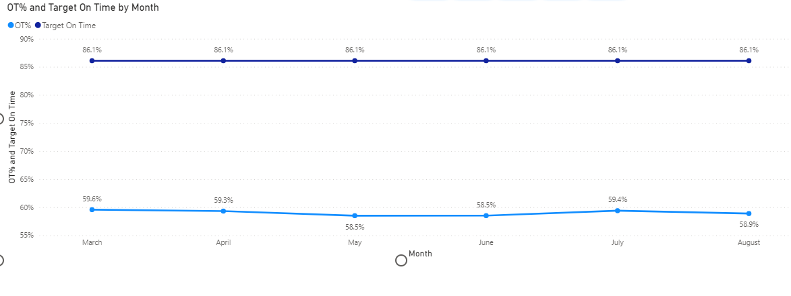
Some Major Insights…
There was no significant improvements in any of the key metrics in the last few months

Slide 11
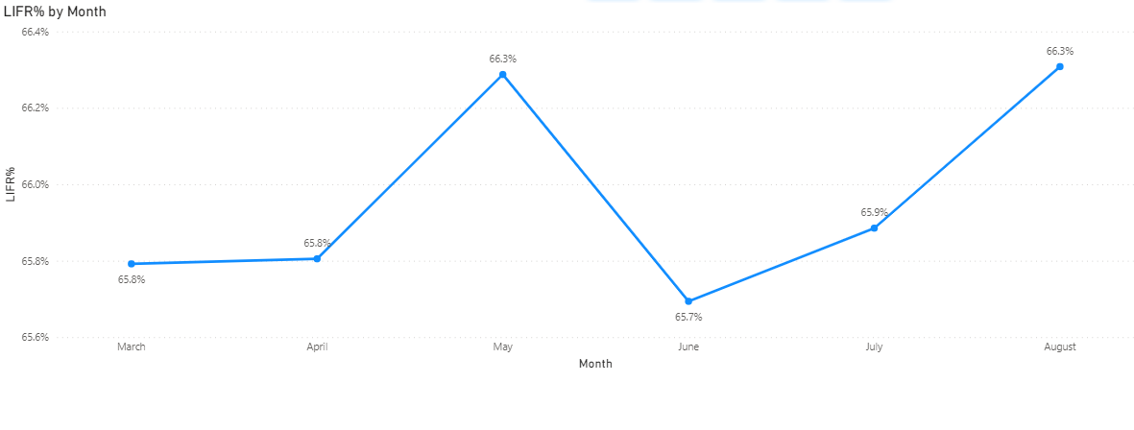
Some Major Insights…
There was fluctuation in LIFR by month with no significant improvement

Slide 12
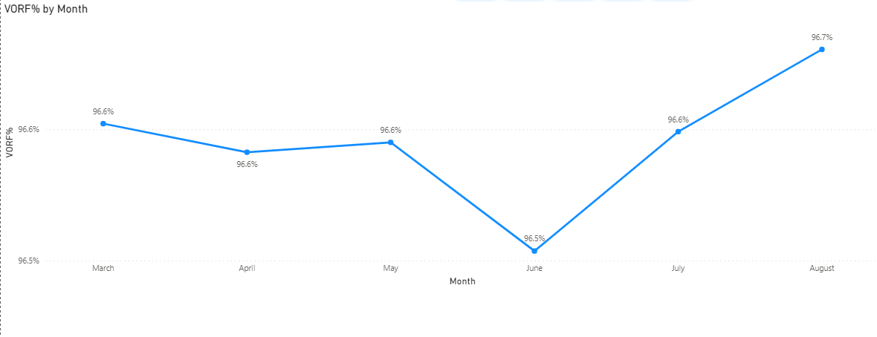
Some Major Insights…
There was fluctuation in VOFR by month with no significant improvement

Slide 13
Conclusion
The key metrics (OT%, IF%, OTIF%) of customer orders on a daily basis and by cities are far behind the target
There was a huge gap in meeting target for OTIF% for most of the customers. This could be as a result of not predicting the right date for delivery and also limited capacity of the supply chain team to deliver the line items in full for the customers.
The Line Fill Rate (LIFR) for customers needs to be improved as the least was at 51.5%
The LIFR for products needs to be improved and these products need to be delivered on the agreed date.

